Slide 1
Presentation Slides for
Project 2 Part 3
Part-Time Data Science
Predictive Maintenance Data
By Vj Esguerra
Resubmitted: 9/26/21

Slide 2
Agenda
Overview
Data Cleaning
Exploratory Visuals

Slide 3
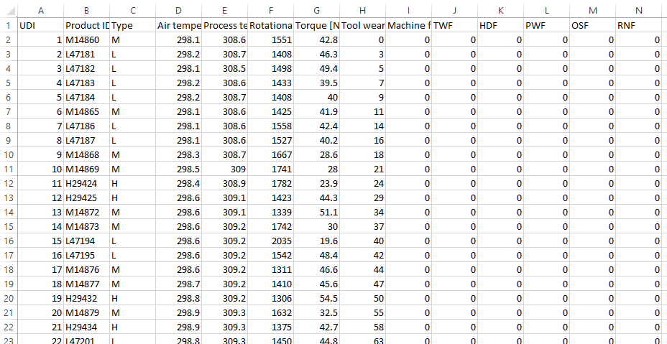
Overview
Data used in this project are from the predictive maintenance dataset located here:
UCI Machine Learning Repository: AI4I 2020 Predictive Maintenance Dataset Data Set

Slide 4
Overview
The data identified by dictionary below was cleaned and explored to find any possible relationships, trends, etc.
Variable Name | Description
UID | unique identifier ranging from 1 to 10000
product ID | consisting of a letter L, M, or H for low (50% of all products), medium (30%) and high (20%) as product quality variants and a variant-specific serial number
air temperature [K] | generated using a random walk process later normalized to a standard deviation of 2 K around 300 K
process temperature [K] | generated using a random walk process normalized to a standard deviation of 1 K, added to the air temperature plus 10 K
rotational speed [rpm] | calculated from a power of 2860 W, overlaid with a normally distributed noise
torque [Nm] | torque values are normally distributed around 40 Nm with a Ïƒ = 10 Nm and no negative values
tool wear [min] | The quality variants H/M/L add 5/3/2 minutes of tool wear to the used tool in the process.
machine failure | label that indicates, whether the machine has failed in this particular datapoint for any of the following failure modes are true.

Slide 5
Overview
The data identified by dictionary below was cleaned and explored to find any possible relationships, trends, etc.
Variable Name | Description
The machine failure consists of five independent failure modes
tool wear failure (TWF) | the tool will be replaced of fail at a randomly selected tool wear time between 200 â€“ 240 mins (120 times in our dataset). At this point in time, the tool is replaced 69 times, and fails 51 times (randomly assigned).
heat dissipation failure (HDF) | heat dissipation causes a process failure, if the difference between air- and process temperature is below 8.6 K and the toolâ€™s rotational speed is below 1380 rpm. This is the case for 115 data points.
power failure (PWF) | the product of torque and rotational speed (in rad/s) equals the power required for the process. If this power is below 3500 W or above 9000 W, the process fails, which is the case 95 times in our dataset.
overstrain failure (OSF) | if the product of tool wear and torque exceeds 11,000 minNm for the L product variant (12,000 M, 13,000 H), the process fails due to overstrain. This is true for 98 datapoints.
random failures (RNF) | each process has a chance of 0,1 % to fail regardless of its process parameters. This is the case for only 5 datapoints, less than could be expected for 10,000 datapoints in our dataset.
If at least one of the above failure modes is true, the process fails and the 'machine failure' label is set to 1. It is therefore not transparent to the machine learning method, which of the failure modes has caused the process to fail.

Slide 6
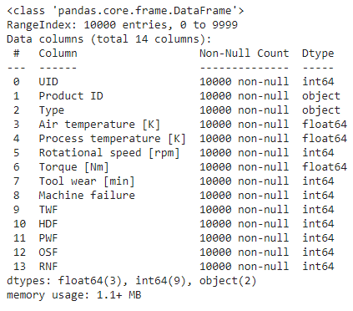
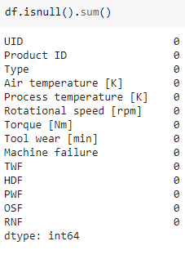
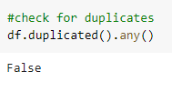
Data Cleaning
The dataset was very clean to begin with:
Data types were appropriate for each column (object for Product ID, Type; float64 for Air temperature, Process temperature, Torque; the rest were int64).
There were no duplicates.
No null values were present in the dataset.

Slide 7
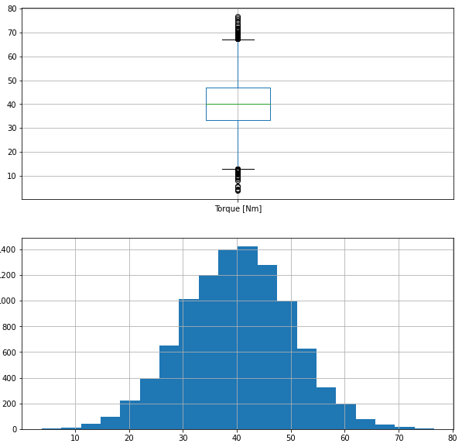
Exploratory Visuals
Several boxplots and histograms were created to visualize the numerical data:
Boxplots aided in the identification of outliers as well as the distribution of the data.
Histograms provided a count of the occurrence of each data value which helped in discerning trends.
The following were learned using the above visualizations:
Rotational speed had outliers beyond the upper whiskers; torque had outliers beyond upper and lower whiskers.
Rotational speed had positive skew to its distribution; tool wear had a uniform distribution

Slide 8
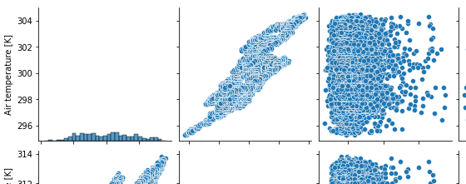
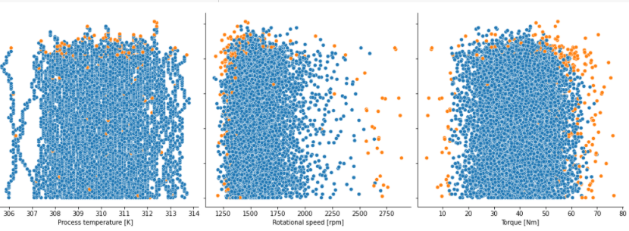
Exploratory Visuals
Pairplots and scatterplots were created to visualize the numerical data:
Pairplot of the entire dataframe gave a “big picture” view of the data.
Based on pairplot of entire dataframe, there seems to be correlation between a) air temperature and process temperature and b) rotational speed and torque.
Scatterplots between each of the features and the target provided a way to see whether there were patterns.
Of interest are the clusters at a) the upper left corner of the tool wear vs. rotational speed and b) the upper right corner of the tool wear vs. torque pairplots.

Slide 9
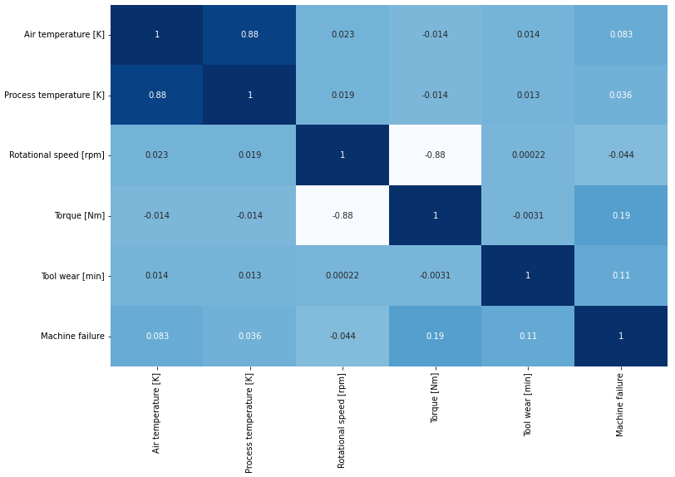
Exploratory Visuals
Correlation heat map was created to visualize the numerical data:
Visually “mapped” the correlation between the numerical features
Positive correlation between air temperature and process temperature (0.88)
Negative correlation between rotational speed and torque (-0.88)
Weak positive correlation between torque and machine failure (0.19)

